Slide 1
Hill Climbing

Slide 2
Hill Climbing Algorithm in Artificial Intelligence
Hill climbing algorithm is a local search algorithm which continuously moves in the direction of increasing elevation/value to find the peak of the mountain or best solution to the problem. It terminates when it reaches a peak value where no neighbor has a higher value.
Hill climbing algorithm is a technique which is used for optimizing the mathematical problems. One of the widely discussed examples of Hill climbing algorithm is Traveling-salesman Problem in which we need to minimize the distance traveled by the salesman.

Slide 3
It is also called greedy local search as it only looks to its good immediate neighbor state and not beyond that.
A node of hill climbing algorithm has two components which are state and value.
Hill Climbing is mostly used when a good heuristic is available.
In this algorithm, we don't need to maintain and handle the search tree or graph as it only keeps a single current state.

Slide 4
Features of Hill Climbing:
Following are some main features of Hill Climbing Algorithm:
Generate and Test variant: Hill Climbing is the variant of Generate and Test method. The Generate and Test method produce feedback which helps to decide which direction to move in the search space.
Greedy approach: Hill-climbing algorithm search moves in the direction which optimizes the cost.
No backtracking: It does not backtrack the search space, as it does not remember the previous states.

Slide 5
State-space Diagram for Hill Climbing:
The state-space landscape is a graphical representation of the hill-climbing algorithm which is showing a graph between various states of algorithm and Objective function/Cost.
On Y-axis we have taken the function which can be an objective function or cost function, and state-space on the x-axis. If the function on Y-axis is cost then, the goal of search is to find the global minimum and local minimum. If the function of Y-axis is Objective function, then the goal of the search is to find the global maximum and local maximum.

Slide 6
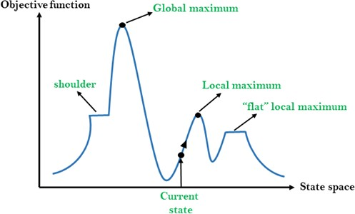

Slide 7
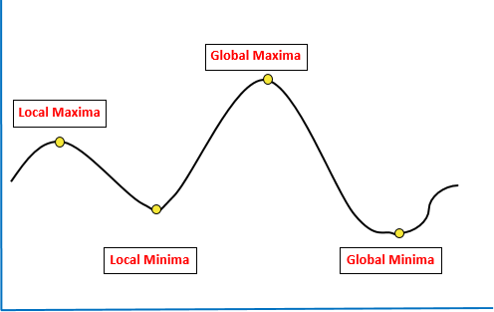
State Space Diagram – Hill Climbing in Artificial Intelligence
Local Maxima/Minima: Local Minima is a state which is better than its neighbouring state, however, it is not the best possible state as there exists a state where objective function value is higher
Global Maxima/Minima: It is the best possible state in the state diagram. Here the value of the objective function is highest
Current State: Current State is the state where the agent is present currently
Flat Local Maximum: This region is depicted by a straight line where all neighbouring states have the same value so every node is local maximum over the region

Slide 8
Problems in Hill Climbing Algorithm:
1. Local Maximum: A local maximum is a peak state in the landscape which is better than each of its neighboring states, but there is another state also present which is higher than the local maximum.
Solution: Backtracking technique can be a solution of the local maximum in state space landscape. Create a list of the promising path so that the algorithm can backtrack the search space and explore other paths as well.
2. Plateau: A plateau is the flat area of the search space in which all the neighbor states of the current state contains the same value, because of this algorithm does not find any best direction to move. A hill-climbing search might be lost in the plateau area.
Solution: The solution for the plateau is to take big steps or very little steps while searching, to solve the problem. Randomly select a state which is far away from the current state so it is possible at the algorithm could find non-plateau region.

Slide 9
3. Ridges: A ridge is a special form of the local maximum. It has an area which is higher than its surrounding areas, but itself has a slope, and cannot be reached in a single move.
Solution: With the use of bidirectional search, or by moving in different directions, we can improve this problem.
Types of Hill Climbing Algorithm:
Simple hill Climbing
Steepest-Ascent hill-climbing
Stochastic hill-climbing
Simple Hill Climbing:
Simple hill climbing is the simplest way to implement a hill climbing algorithm. It only evaluates the neighbor node state at a time and selects the first one which optimizes current cost and set it as a current state. It only checks it's one successor state, and if it finds better than the current state, then move else be in the same state. This algorithm has the following features:
Less time consuming
Less optimal solution and the solution is not guaranteed

Slide 10
Algorithm for Simple Hill Climbing:
Step 1: Evaluate the initial state, if it is goal state then return success and Stop.
Step 2: Loop Until a solution is found or there is no new operator left to apply.
Step 3: Select and apply an operator to the current state.
Step 4: Check new state:
If it is goal state, then return success and quit.
Else if it is better than the current state then assign new state as a current state.
Else if not better than the current state, then return to step2.
Step 5: Exit
Steepest-Ascent hill climbing:
The steepest-Ascent algorithm is a variation of simple hill climbing algorithm. This algorithm examines all the neighboring nodes of the current state and selects one neighbor node which is closest to the goal state. This algorithm consumes more time as it searches for multiple neighbors

Slide 11
Algorithm for Steepest-Ascent hill climbing:
Step 1: Evaluate the initial state, if it is goal state then return success and stop, else make current state as initial state.
Step 2: Loop until a solution is found or the current state does not change.
Let SUCC be a state such that any successor of the current state will be better than it.
For each operator that applies to the current state:
Apply the new operator and generate a new state.
Evaluate the new state.
If it is goal state, then return it and quit, else compare it to the SUCC.
If it is better than SUCC, then set new state as SUCC.
If the SUCC is better than the current state, then set current state to SUCC.
Step 3: Exit.

Slide 12
Stochastic hill climbing: It does not examine all the neighboring nodes before deciding which node to select. It just selects a neighboring node at random and decides (based on the amount of improvement in that neighbor) whether to move to that neighbor or to examine another.
Step 1: Evaluate the initial state. If it is a goal state then stop and return success. Otherwise, make the initial state the current state.
Step 2: Repeat these steps until a solution is found or the current state does not change.
a) Select a state that has not been yet applied to the current state.
b) Apply successor function to the current state and generate all the neighbor states.
c) Among the generated neighbor states which are better than the current state choose a state randomly (or based on some probability function).
d) If the chosen state is the goal state, then return success, else make it the current state and repeat step 2: b) part.
Step 3: Exit.

Slide 13
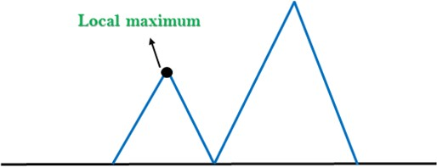
Problems in Hill Climbing Algorithm
1. Local Maximum: A local maximum is a peak state in the landscape which is better than each of its neighboring states, but there is another state also present which is higher than the local maximum.
Solution: Back Propagation can mitigate the problem of Local maximum as it starts exploring alternate paths when it encounters Local Maximum

Slide 14
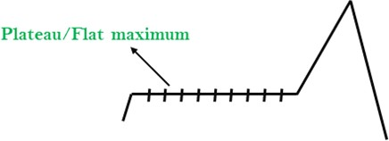
Problems in Hill Climbing Algorithm
2. Plateau: A plateau is the flat area of the search space in which all the neighbor states of the current state contains the same value, because of this algorithm does not find any best direction to move. A hill-climbing search might be lost in the plateau area.
Solution: The solution for the plateau is to take big steps or very little steps while searching, to solve the problem. Randomly select a state which is far away from the current state so it is possible that the algorithm could find non-plateau region.

Slide 15
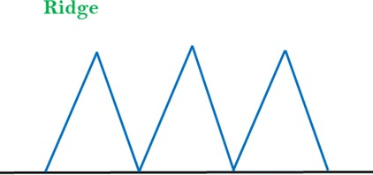
Problems in Hill Climbing Algorithm
3. Ridges: A ridge is a special form of the local maximum. It has an area which is higher than its surrounding areas, but itself has a slope, and cannot be reached in a single move.
Solution: Ridge obstacle can be solved by moving in several directions at
the same time
Solution: With the use of bidirectional search, or by moving in different
directions, we can improve this problem.

